Slide 1






Flutter
E-COMMERCE
APP
Presented by SW3E
DEPI Project presentation

Slide 2





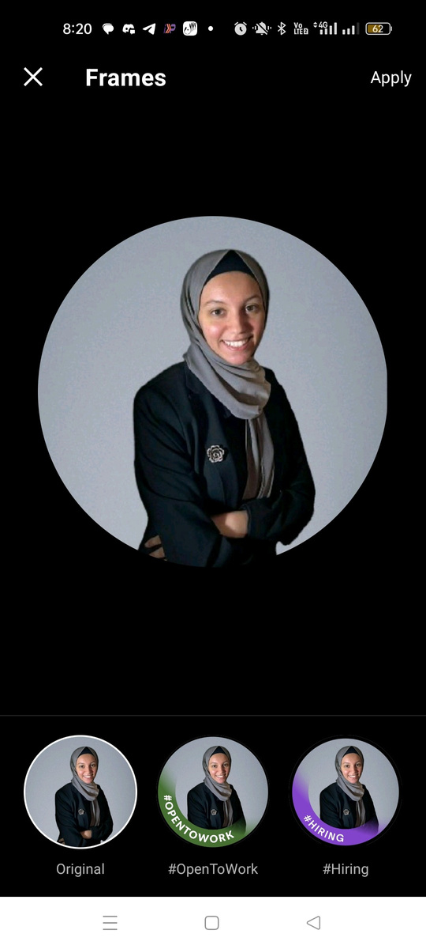
Salford & Co.
PROFESSIONAL
TEAM
Arsany Morcos
Mariem Elsaid
Mobile App developer
Flutter Developer
Team Members
Gaser Youssef
Mohamed
Malak Amgad
Software Engineer
Flutter Developer
AI Engineer

Slide 3



Flutter
AGANDA
Introduction
Analysis
Design
Implementation
Conclusion
/user

Slide 4



Flutter
INTRODUCTION
Welcome to our presentation on the E-commerce App project. This app is designed to deliver a seamless and enjoyable online shopping experience. With features like personalized home pages, product search, shopping cart, user profiles, and a guided onboarding experience, our e-commerce platform aims to make shopping easy, fast, and secure. Built using Flutter for cross-platform compatibility and integrated with Firebase Authentication and Firestore for user management and data storage, this app combines functionality with a clean, modern design that caters to the needs of today’s online shoppers.

Slide 5

Flutter
ANALYSIS
/user

Slide 6
flutter
PROBLEM STATMENT
Users require a platform to browse, search, and purchase products seamlessly.
E-commerce apps must ensure efficient navigation, personalization, and Validation.
/user

Slide 7
flutter
OBJECTIVES
Provide a user-friendly app with essential e-commerce functionalities.
Ensure secure user authentication and seamless data interaction through APIs.
/user

Slide 8


flutter
TRAGET
AUDIENCE
Online shoppers who value convenience, speed, and security in mobile commerce.
/user

Slide 9
flutter
FUNCTIONAL REQUIREMENTS
User Management
Core Features

Slide 10

flutter
USER MANAGEMENT
CORE FEATURES
HOME PAGE
SEARCH
CART
PROFILE PAGE
ONBOARDING EXPERIENCE
VALIDATION

Slide 11


flutter
TECHNICAL REQUIREMENTS
Frontend
Flutter framework for cross-platform compatibility.
Backend:
Firebase Authentication for user management.
Cloud Firestore for real-time database management.
APIs:
Fetching products and categories from the provided REST API .
/user

Slide 12


Salford & Co.
DESIGN

Slide 13

Salford & Co.
UI/UX GOALS
EASE OF USE
AESTHETIC APPEAL
CONSISTENCY

Slide 14
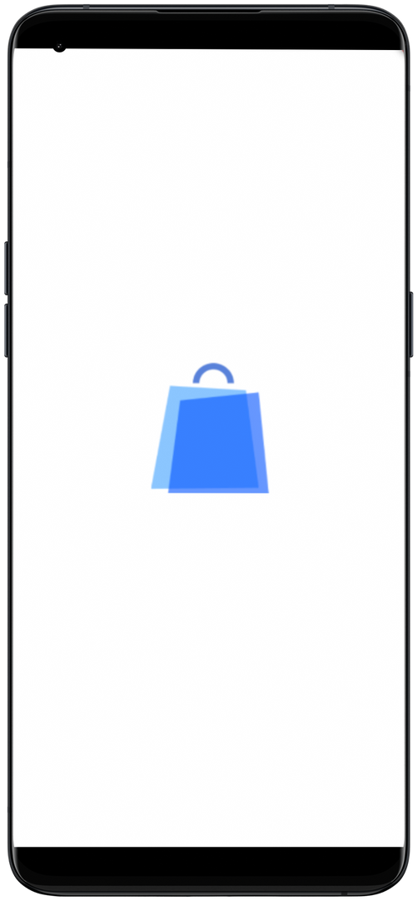
flutter
SCREENS
Splash Screen:
App logo with a short fade-in animation.
/user

Slide 15
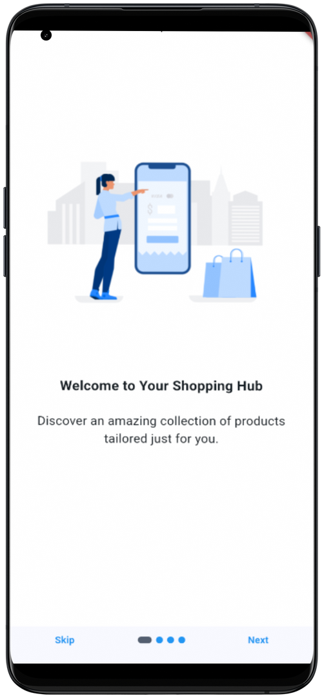
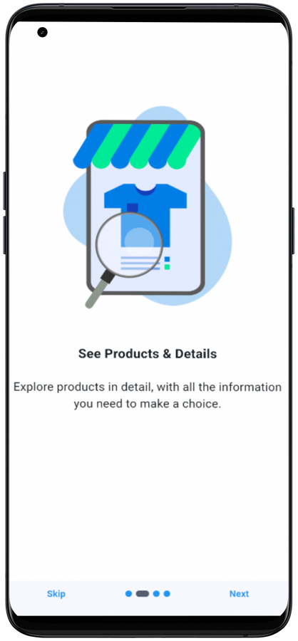
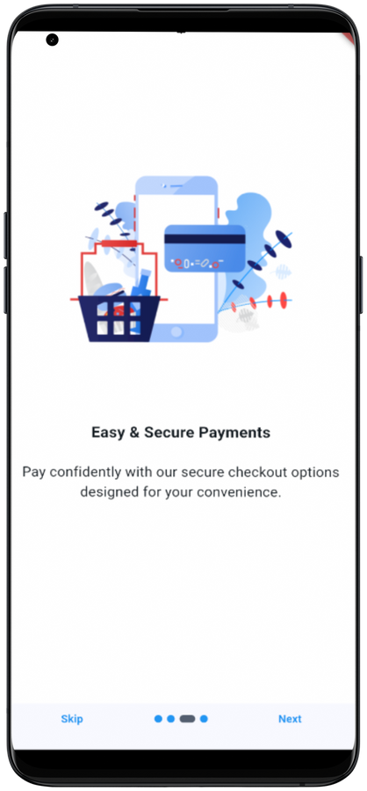
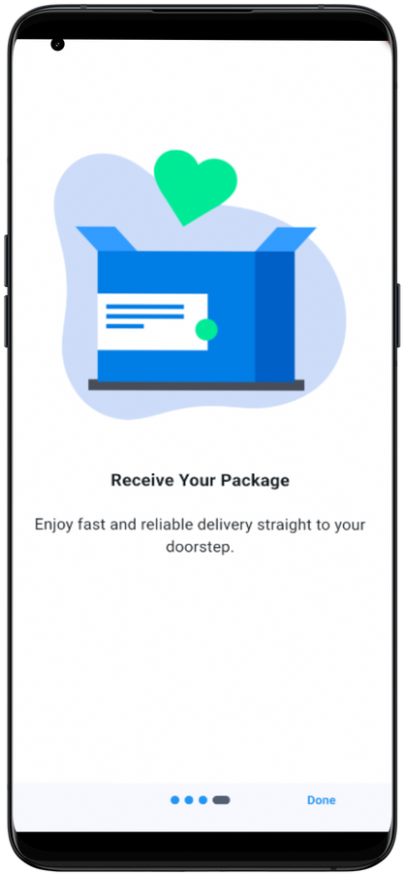
flutter
ONBOARDING SCREENS
Carousel views using the introduction_screen package.
Feature highlights
Easy shopping
Product details
secure Payment
receive Package

Slide 16
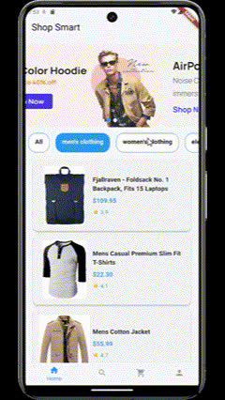
flutter
HOME PAGE
Featured products section with scrollable categories.
categories at the top for quick access.
shimmer and card swiper packages
/user

Slide 17
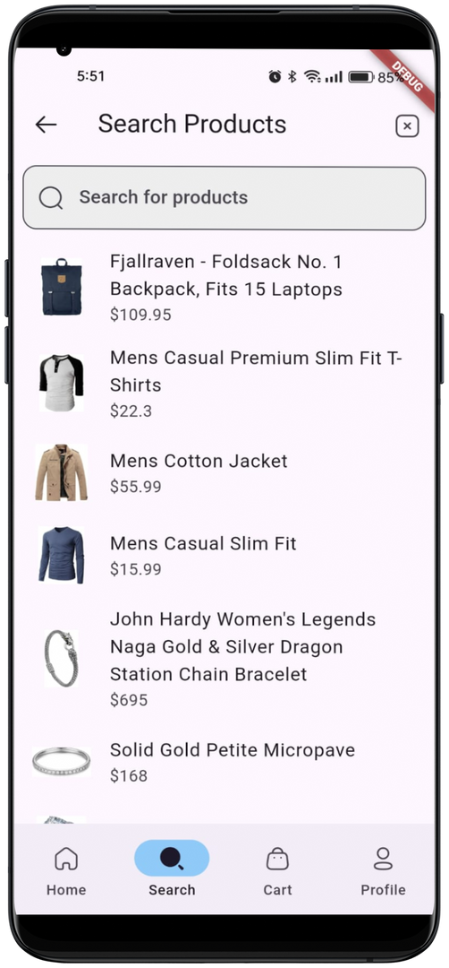
flutter
SEARCH SCREEN
Input field for keyword-based search.
List of matching products dynamically populated.
/user

Slide 18
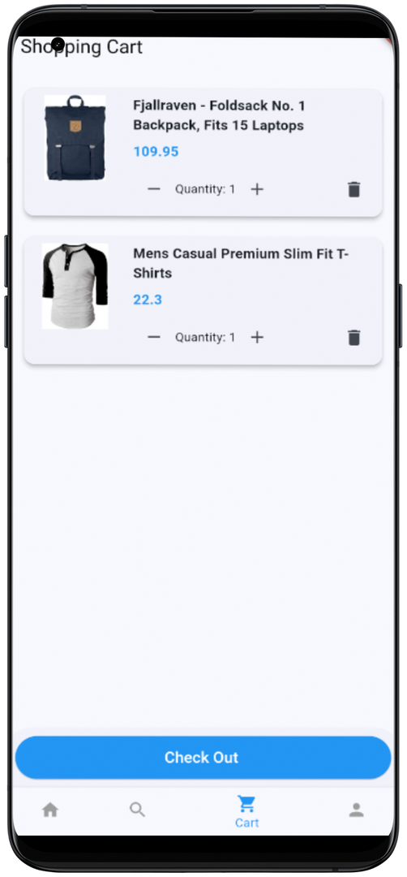
flutter
CART PAGE
List view of selected items with total cost displayed.
Option to update quantity or remove items.
/user

Slide 19
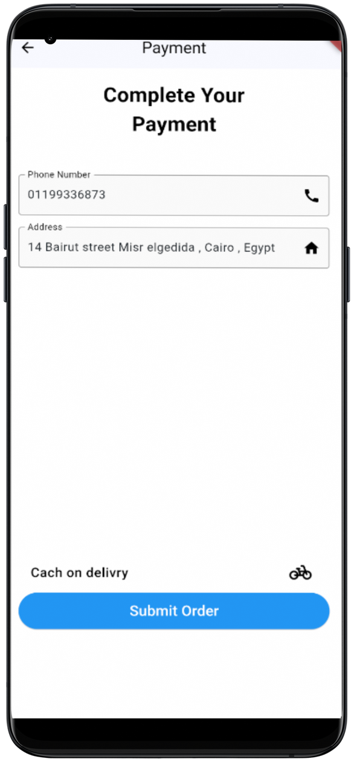
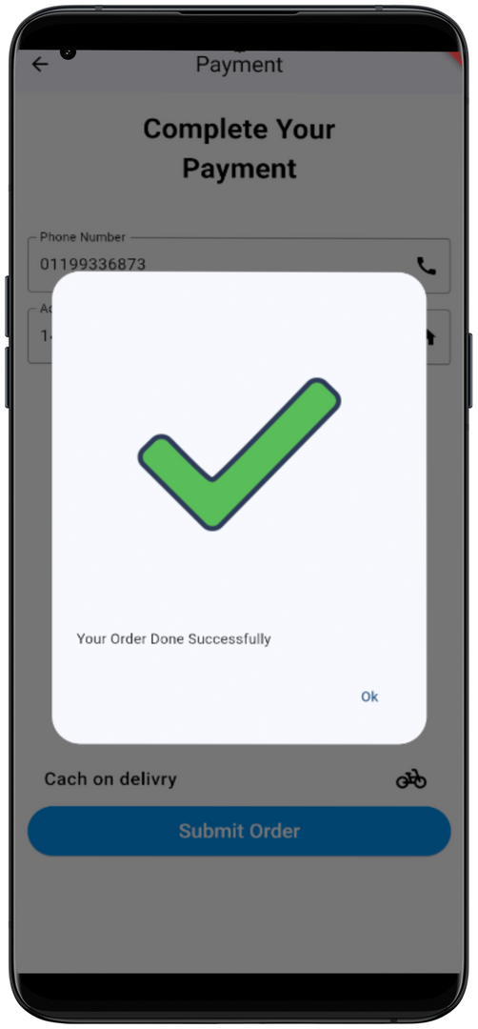
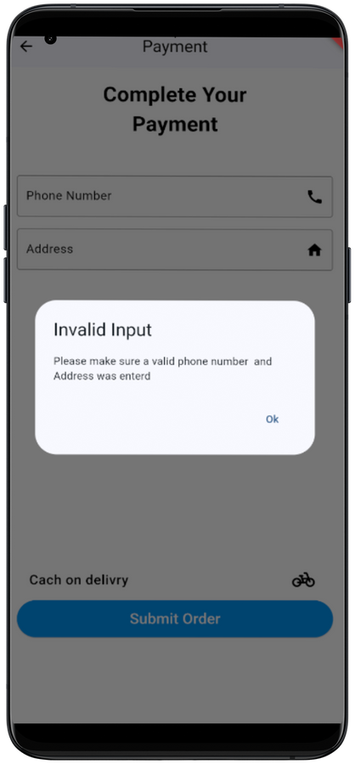
flutter
CHECKOUT
Fast Checkout with successful widget .

Slide 20
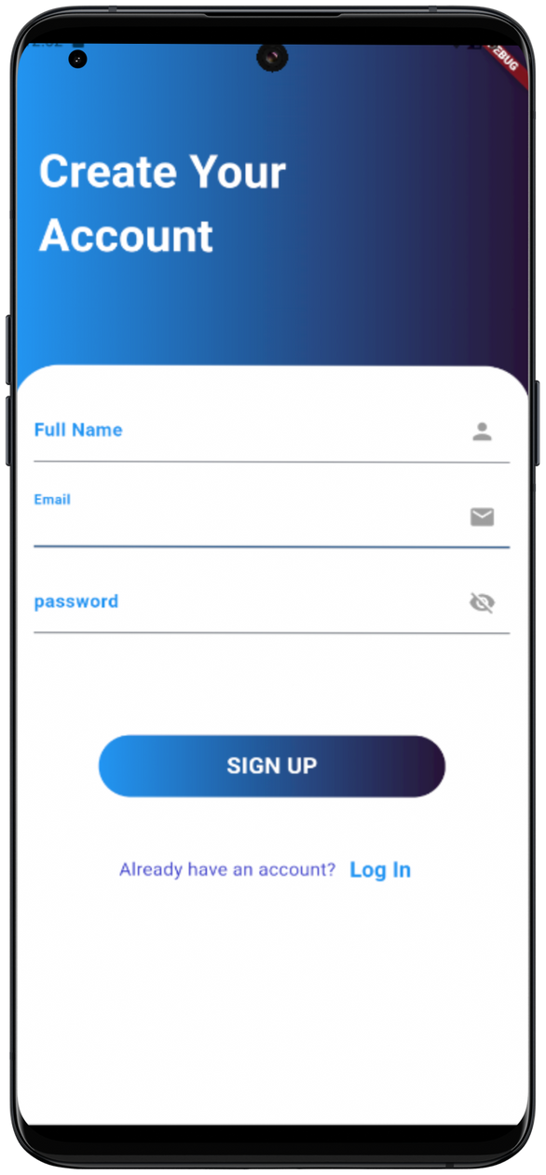
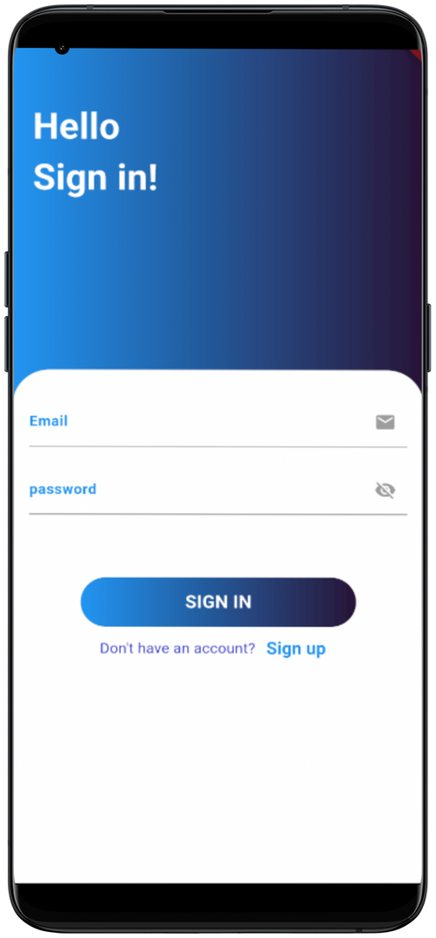
flutter
PROFILE PAGE:
User details (name, email).
Navigation for settings and logout.
/user

Slide 21

flutter
STYLE GUIDE
COLOR PALETE
LAYOUTS
Grid Structure
space around
card:floating appearance
TYPOGRAPHY
ROBOTO
REGULAR WEIGHT MEDIUM SIZE
ICONS
Underlined text

Slide 22



flutter
IMPLEMENTATION

Slide 23


flutter
ARCHITECTURE
FRONTEND
Widget-based structure for reusability.
Organized files: screens, widgets, models, services.
BACKEND
Firebase for authentication and data storage.
REST API integration for product management.

Slide 24




flutter
KEY FEATURES
USER AUTHENTICATION
PRODUCT DISPLAY
user authentication
validation
dinamic loading via API
ListView and GridView for layouts.
CART MANAGEMENT
Stateful widget to manage cart items.
Real-time updates based on changes.

Slide 25


flutter
KEY FEATURES
ERROR HANDLING
PACKAGES
Graceful error messages for API failures.
Retry mechanisms for failed API requests.
different flutter package where used

Slide 26

flutter
TECHNOLOGIES & DEPENDENCIES
PACKAGES
FLUTTER
introduction_screen
flutter_launcher_icons
firebase_auth
cloud_firestore
card_swiper
cupertino_icons
iconly
card_swiper
cupertino_icons
fancy_shimmer_image
Framework for cross-platform development.
FIREBASE
firebase_auth
cloud_firestore

Slide 27
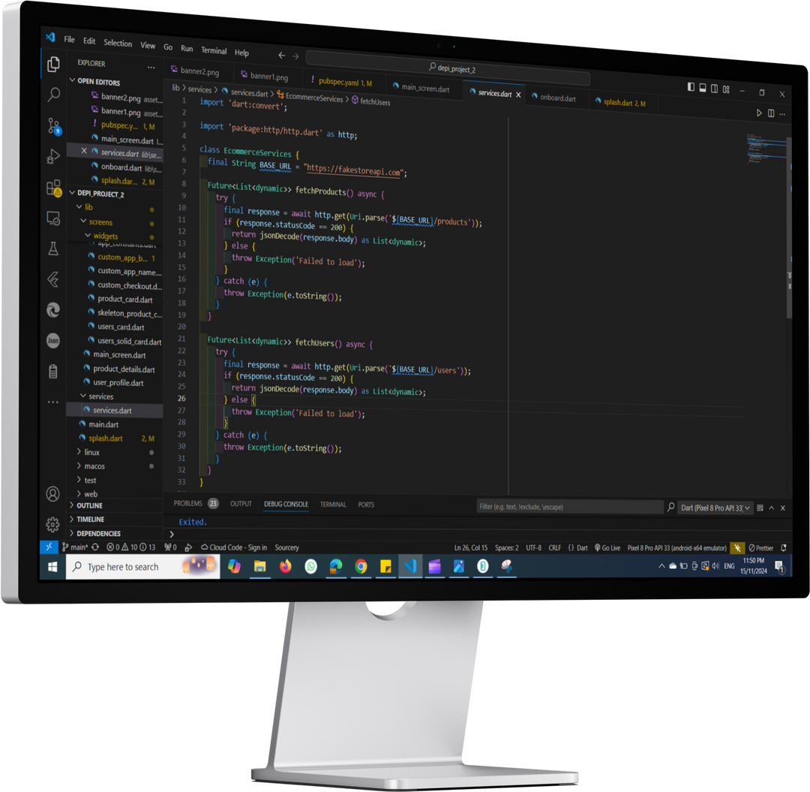
flutter
CODE SNIPPETS

Slide 28
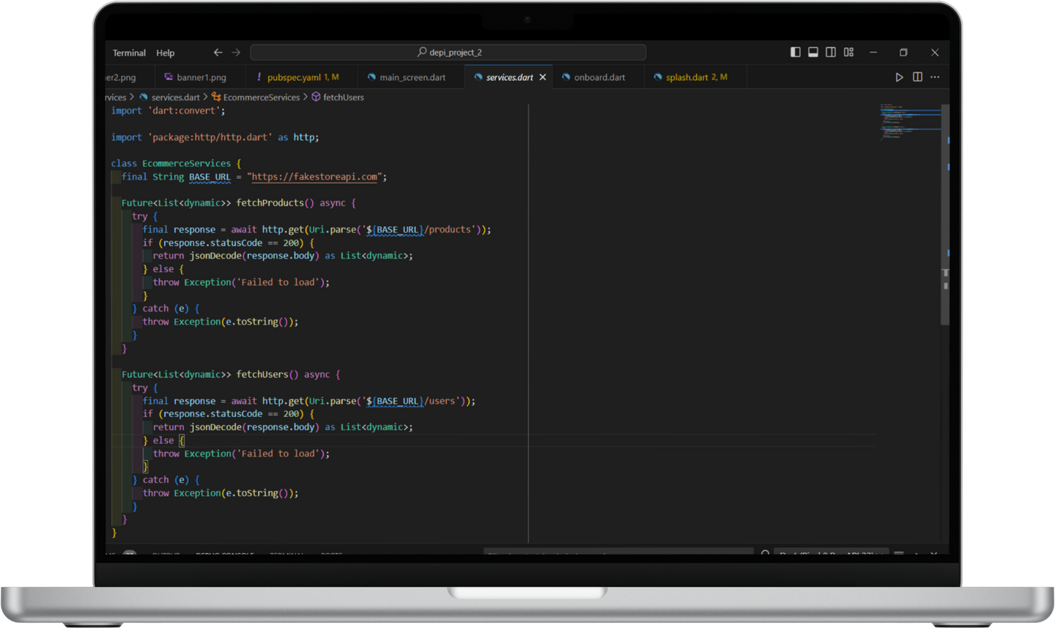
flutter
API INTEGRATION

Slide 29
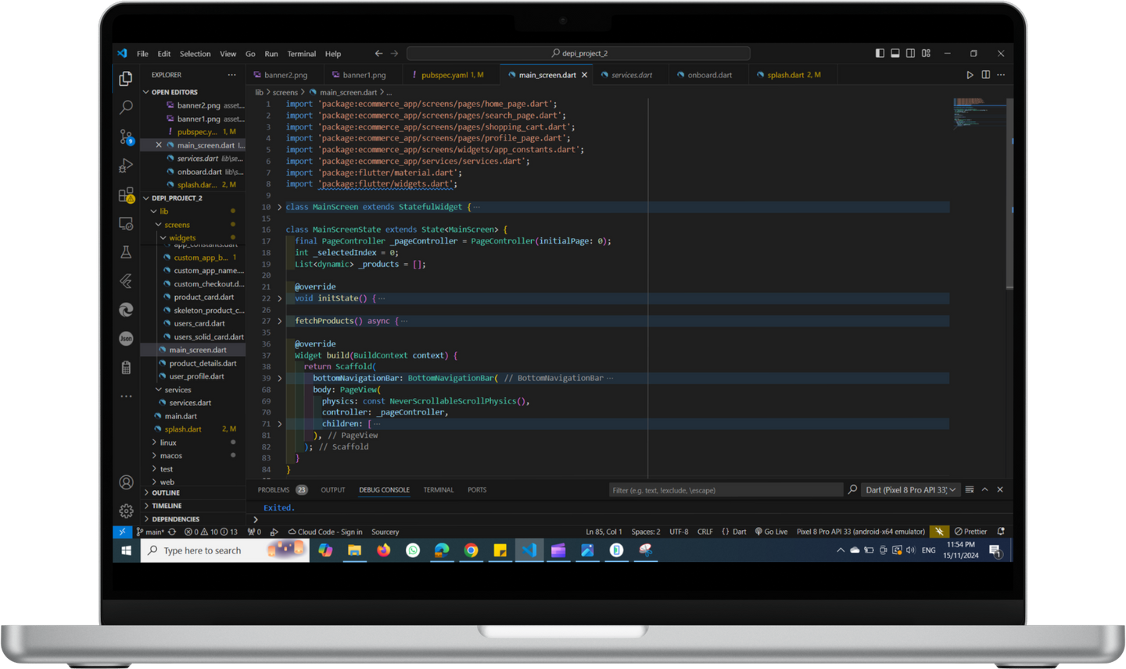
flutter
HOME PAGE

Slide 30

Flutter
CHALLENGES
MANAGING API ERRORS.
Solution: Implemented error handling and retry mechanisms.
MANAGING API ERRORS.
Solution: Used Flutter’s MediaQuery for adaptive layouts.

Slide 31

flutter
CONCLUSION
The app provides a robust e-commerce solution with essential features like user authentication, dynamic product listing, and cart management.
Future enhancements can include payment gateway integration, order tracking, and notifications.

Slide 32

Flutter
QUESTIONS?

Slide 33

Flutter

